Slide 1
Database System
Instructor:
Sadiq Shah
(Lecture 05)

Slide 2
MODELING RELATIONSHIPS

Slide 3
MODELING RELATIONSHIPS
Relationships are the glue that holds together the various components of an E-R model.
A relationship is an association representing an interaction among the instances of one or more entity types that is of interest to the organization.
A relationship has a verb phrase name.
Example:
consider the entity types EMPLOYEE and COURSE

Slide 4
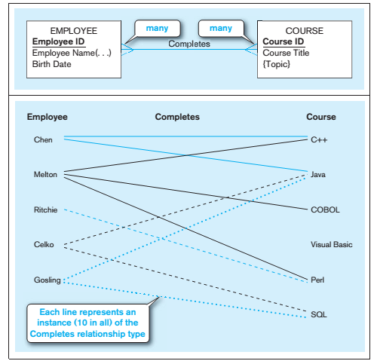

Slide 5
Basic Concepts and Definitions in Relationships
Relationship type
A meaningful association between (or among) entity types.
A relationship type is denoted by a line labeled with the name of the relationship.
A relationship instance is an association between (or among) entity instances, where each relationship instance associates exactly one entity instance from each participating entity type
For example, the line between Employee Ritchie to Course Perl is one relationship instance.

Slide 6
ATTRIBUTES ON RELATIONSHIPS:
It is probably obvious to you that entities have attributes, but attributes may be associated with a many-to-many (or one-to-one) relationship, too.
For example, suppose the organization wishes to record the date (month and year) when an employee completes each course. This attribute is named Date Completed.
Where should the attribute Date Completed be placed on the E-R diagram???
ASSOCIATIVE ENTITIES:
The presence of one or more attributes on a relationship suggests to the designer that the relationship should perhaps instead be represented as an entity type.

Slide 7
Associative entity
An entity type that associates the instances of one or more entity types and contains attributes that are peculiar to the relationship between those entity instances.

Slide 9
Degree of a Relationship
UNARY RELATIONSHIP
BINARY RELATIONSHIP
TERNARY RELATIONSHIP

Slide 10
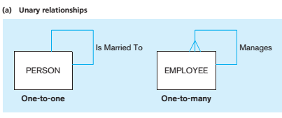
UNARY RELATIONSHIP
A unary relationship is a relationship between the instances of a single entity type.
(Unary relationships are also called recursive relationships.)

Slide 11
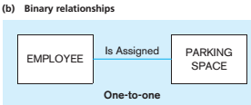
BINARY RELATIONSHIP
A binary relationships is a relationship between the instances of two entity types and is the most common type of relationship encountered in data modeling.

Slide 12
TERNARY RELATIONSHIP
A ternary relationship is a simultaneous relationship among the instances of three entity types.

